Slide 1
Megaproject Governance and Leadership: Designing Solutions for a Collective Action Problem
Nuno Gil
Professor of New Infrastructure Development
Centre for Infrastructure Development, Manchester Business School
Engineering Project Organizations Conference (EPOC) 2015
Edinburgh
© Nuno A. Gil. All Rights Reserved
Notes:
Like a kaleidoscope in which the view changes as it is rotated, any collaboration can be transformed as issues are addressed in this way

Slide 2
Empirical phenomena
Megaprojects: a form of public-private partnership
© Nuno A. Gil. All Rights Reserved

Slide 3
Theoretical lens
Organizational and design theory
© Nuno A. Gil. All Rights Reserved

Slide 4
Authority hierarchies legitimized by ownership stakes (firm), regulation (government), employer-employee relationships Markets legitimized by legal contracts Clans and meritocracy-based authorities legitimized by homogeneity of logics, backgrounds, beliefs, kinship
Conventional Structures
© Nuno A. Gil. All Rights Reserved

Slide 5
New forms of (Meta) Organizing
[Gulati et al. 2012]
 | Low-stratification/heterarchical decision-making | High-stratification/hierarchical decision-making
Closed boundaries | Closed community Consortia, technical standard committees | Extended enterprise OEM-supplier networks, franchising networks
Open boundaries | Open community Wikipedia, open source | Managed ecosystem Android operating system Social networks
Networks aren’t self-organizing systems!
© Nuno A. Gil. All Rights Reserved

Slide 6
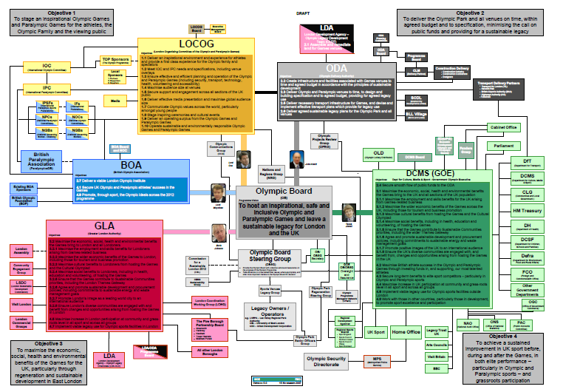
What is the structure of a megaproject?
© Nuno A. Gil. All Rights Reserved

Slide 7
Can we trace prevailing (under) performance back to structure?
© Nuno A. Gil. All Rights Reserved

Slide 8
Intuition
SLACK
Ideation
Planning
Delivery
© Nuno A. Gil. All Rights Reserved

Slide 9
The arrival of the stakeholders
Ideation
Planning
Delivery
© Nuno A. Gil. All Rights Reserved

Slide 10
The arrival of the suppliers
Ideation
Planning
Delivery
© Nuno A. Gil. All Rights Reserved

Slide 11
After contract award…
In a 3-year, £300m sub-project, 1,000 claims (~one claim/day)
© Nuno A. Gil. All Rights Reserved

Slide 12
Massive work coordination costs!
..underground utilities, design and construction issues, stakeholder issues, etc
© Nuno A. Gil. All Rights Reserved

Slide 13
Playing games…
© Nuno A. Gil. All Rights Reserved

Slide 14
Operating with limited slack
© Nuno A. Gil. All Rights Reserved

Slide 15
Strategic misrepresentation, optimism bias, botched front-end, or a collective-action problem?
© Nuno A. Gil. All Rights Reserved

Slide 16
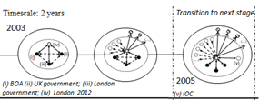
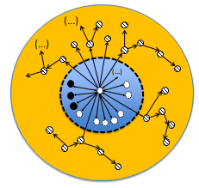
Mega-projects are hybrid networks
Stakeholders are part of the problem, part of the solution
© Nuno A. Gil. All Rights Reserved

Slide 17
Mega-projects, both organization and outcomes, are systems of non-decomposable components
Design rules
A
E
B
C
D
© Nuno A. Gil. All Rights Reserved

Slide 18
And the design-in-the-making (scope) is a shared resource
Excludability from development | Rivalry in design choices
 | Low (modular design) | High (integral design)
High (individual) | Individuals assemble their own systems of modules Personal computer, personal library, personal wardrobe | Private goods: producers design indivisible templates with modular variants; or users design for themselves Coffee-maker, hand-knitted sweater, single-family house
Low (shared) | Individuals share modules and modular/mix-and-match designs Social networks, open source software | Collective action problem! Indivisible designed artifacts to be shared in use Megaprojects: systems of non-decomposable components
© Nuno A. Gil. All Rights Reserved
Notes:
Like a kaleidoscope in which the view changes as it is rotated, any collaboration can be transformed as issues are addressed in this way

Slide 19
Implications
© Nuno A. Gil. All Rights Reserved
Notes:
Like a kaleidoscope in which the view changes as it is rotated, any collaboration can be transformed as issues are addressed in this way

Slide 20
Implications to theory
A ‘new’ form of organizing: a hybrid network
Combines open pluralistic structures with closed, hierarchical structures
Link between structural evolution-performance ambiguity
Performance evaluation varies as a function of the reference structure
Design-in-the-making (scope) as an ‘artificial’ shared resource
At the core, free-riding and uncooperative behaviour do a lot of harm
Can we predict performance by anticipating structure?
work-in-progress…currently exploring correlations…
© Nuno A. Gil. All Rights Reserved

Slide 21
Research Outlook
Consensus-oriented networks remain underexplored
i) Strategic capabilities: how can the systems architect (leading coalition) attenuate misalignment problems at the core?
ii ) Effective Governance: decentralisation, micro-processes
iii) Innovation: quite difficult in consensus-oriented networks
iv) Make-buy problem: how does it change w/ ‘pluralistic’ buyer ?
© Nuno A. Gil. All Rights Reserved

Slide 22
So what?
© Nuno A. Gil. All Rights Reserved

Slide 23
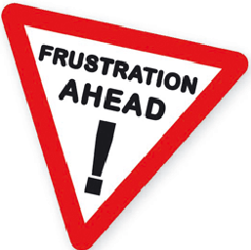
Manage performance expectations
Delay public announcements of fixed budgets
Introduce ‘soft’ openings (stagger expected opening date over a period of time ...if at all possible…)
Easy to say, hard to actually do it …due to electoral cycles, markets’ appetite for bold announcements
© Nuno A. Gil. All Rights Reserved

Slide 24
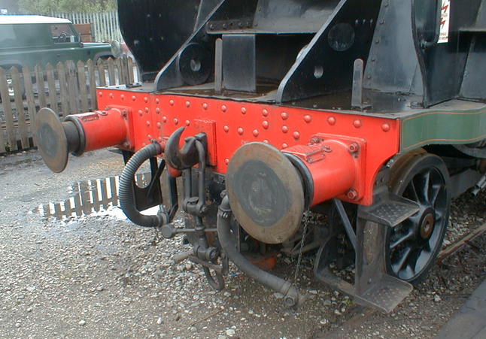
Design in contingencies wisely
Contingencies are buffers that build organizational slack, and thus ‘mask’ slippages in performance targets
But contingencies commit resources that could be better used elsewhere
And the risk is real that the
more resources (time,
money) you throw into the
pot, the more resources
will be spent
© Nuno A. Gil. All Rights Reserved

Slide 25
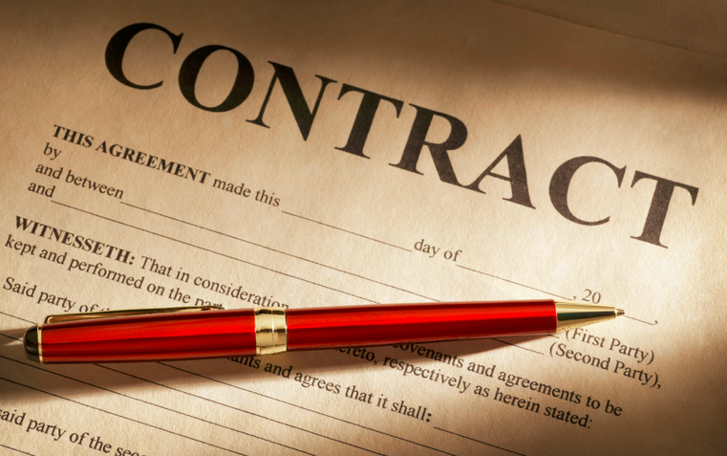
Flexible contracts aren’t a panacea
Reimbursable contracts with built-in targets are more flexible to cope with pluralism => likelihood of litigation goes down
And perception that in reimbursable contracts risks are shared potentially brings down the costs of the bids. BUT!!!
Uncertainty from unresolved controversies and work coordination problems is inevitable
And so is cost escalation
© Nuno A. Gil. All Rights Reserved

Slide 26
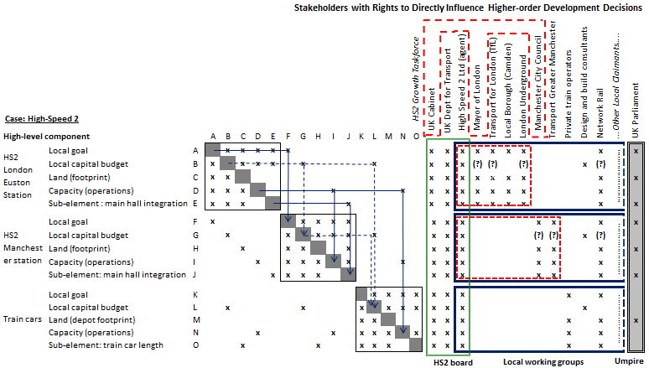
Design decentralized governance structures
© Nuno A. Gil. All Rights Reserved

Slide 27
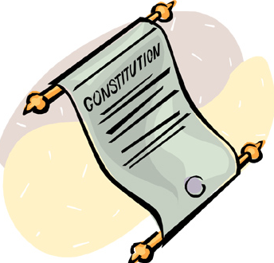
Encourage Collaboration
Design a constitution to set the high-level rules of the game
Let problem-solving move up and downwards through relationships of deference
Create opportunities for intense face-to-face communication, mutual adjustment, but also for tough negotiation and bargaining
Communication encourages cooperation, and keeps a lot of the politics at bay
© Nuno A. Gil. All Rights Reserved

Slide 28
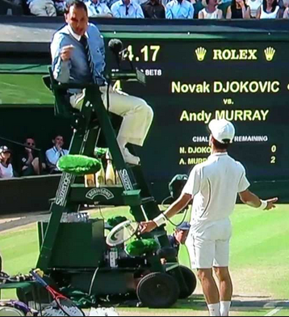
And be pragmatic!
Design a structure of nested umpires
Intense communication alone will not solve all controversies when stakes are high and resources scarce
Consensus takes time to reach
Free-riders (narrowly self-interested individuals) ~20% of population !!
© Nuno A. Gil. All Rights Reserved

Slide 29
In conclusion
Megaprojects create large arenas of collective action, and thus require robust consensus-oriented governance to:
Encourage social norms of collaboration to flourish
Prevent creation of a politically-charged organization
© Nuno A. Gil. All Rights Reserved

Slide 30
Last Thought
DATA, DATA, DATA!
© Nuno A. Gil. All Rights Reserved

